Slide 1

HR DATASET ANALYSIS
KARMUKILAN D K

Slide 2
Contents
About Dataset
Summary statistics
Data Insights
Conclusion

Slide 3
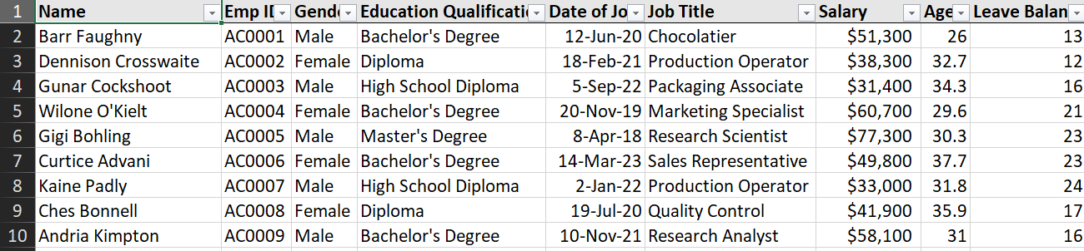
About Dataset
9 Columns and 161 Rows of Data

Slide 4
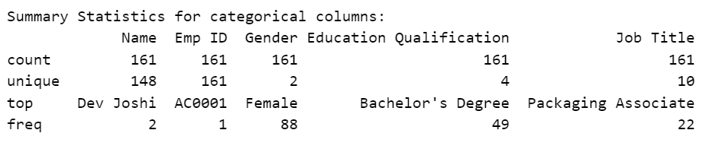
Statistical Insight

Slide 5
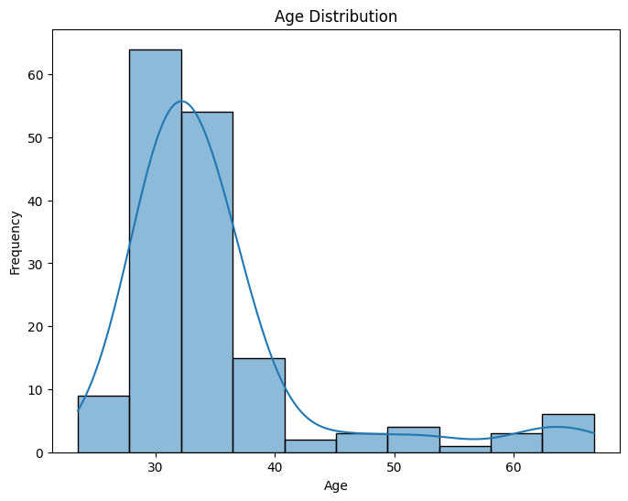
Age Distribution

Slide 6
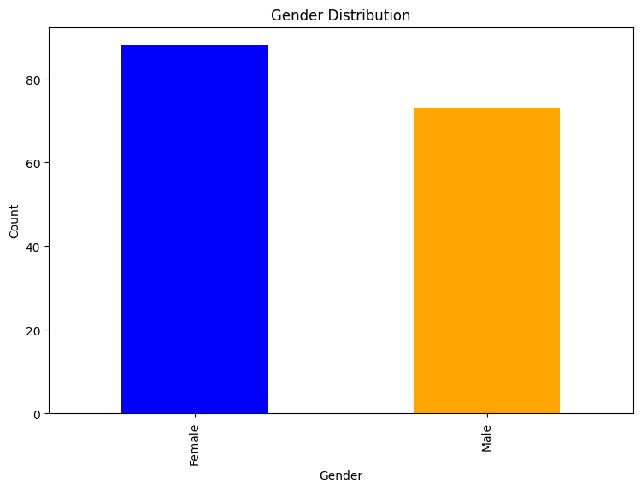
Gender Distribution

Slide 7
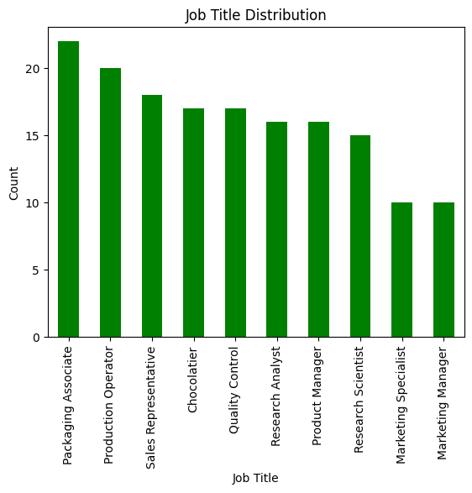
Job Distribution

Slide 8
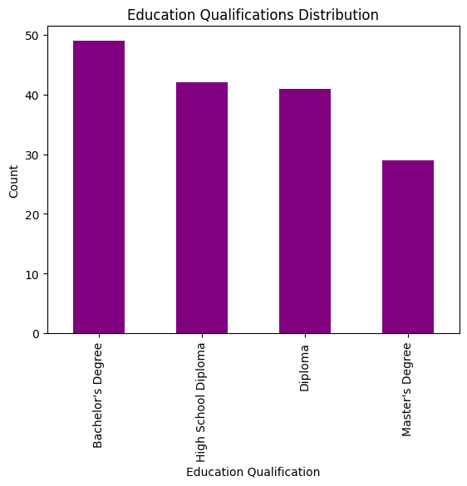
Educational
Distribution

Slide 9
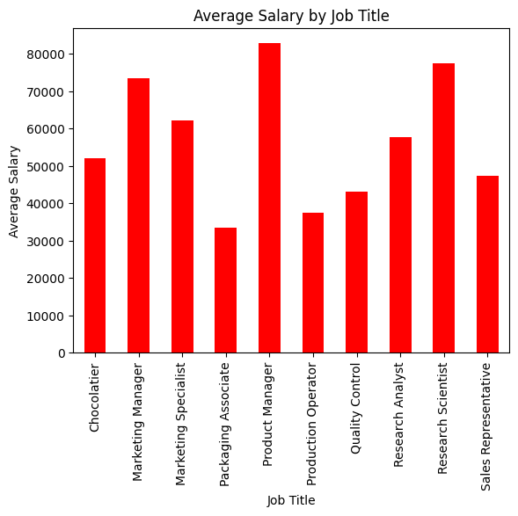
Average Salary
by Job

Slide 10
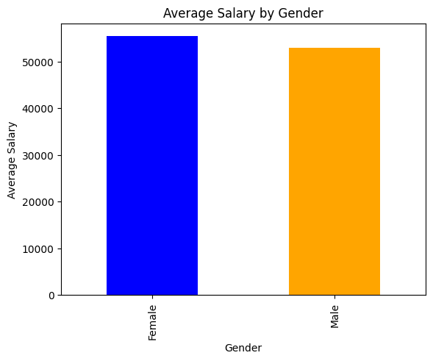
Average Salary by Gender

Slide 11
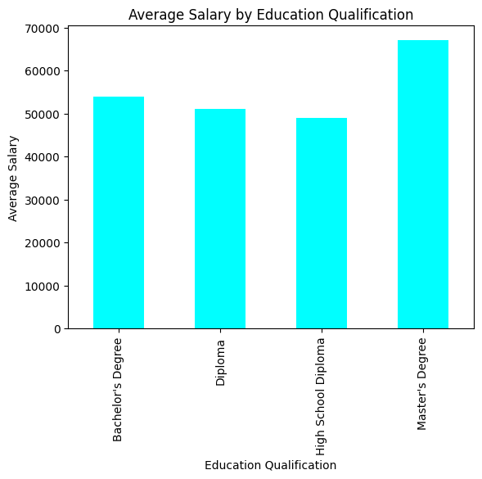
Average Salary
by Education

Slide 12
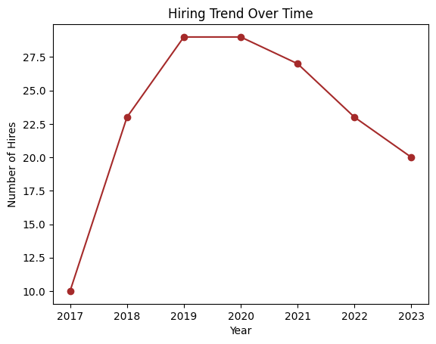
Hiring Trend

Slide 13
Conclusion
Gender distribution shows a predominance of Females within the dataset.
Job distribution indicates Packaging Associate as the most prevalent role.
Educational distribution highlights Bachelor's Degree as the predominant qualification.
The average salary by job reveals Product Manager as the highest-paid role, followed by Research Scientist, with Packaging Associate being the least compensated.
Gender-wise, Females tend to earn slightly more than Males on average.
In terms of educational qualifications, individuals with a Master's Degree got highest average salary, followed by those with Bachelor's Degrees, Diplomas, and High School Diplomas, respectively.
Analyzing the hiring trend, there was a noticeable increase from 2018 to 2019, followed by stability until 2020. However, there was a gradual decline from 2020 onwards, with successive drops observed from 2020 to 2023.

Slide 14
THANK YOU

